Slide 1
Hashing and Digital Signatures

Slide 2
Hashes
One-way algorithm
Encryption can only work one way, can not be reversed
Thus, you can not recover the original password
This helps keep password confidentiality
Common uses
Verify a downloaded data is the same as the original data
Digital signatures

Slide 3
Hash Examples
SHA224 (224 bits)
Password: NICERC
SHA224 Hash: a771341621adb584d963401f83c50a727b8fd3268572830a50a42035
Password: nICERC
SHA224 Hash: 8f23d28facc5c604adb5f50196f60af70ec58d8e38d72deb3c461690
MD5 (128 bits)
Password: NICERC
MD5 Hash: 962d07c231a9c3dd52822be8f857fb67
Password:NIcERC
MD5 Hash: ff12dfa035134708287d104b8e1acc0b

Slide 4
Collision
Collision is two different inputs have the same output
Hashing should never have two different passwords have the same hash
Hash should be unique
There are some examples where hashes give the same output
Very rare
1 in a million if/when they are found

Slide 5
Salt, IV, Nonce
Salt is a random data used for additional input to a hashing algorithm (or one-way algorithm)
Password: NICERCe7y65i84jf83idj
SHA224 Hash: 2e487f3bab07c5d1a205cab4630336360acf23bc115e0567e2d00bcb
Password: NICERCj4l3ld092kldl377
SHA224 Hash: 67cad04d9d9e4c6b5c43e0e1e0d0a3446707584b7c0029b20e6d1a77
IV (Initialization Vector) is mainly used in for wireless connections
A nonce is a salt that is only used once
Different Salts

Slide 6
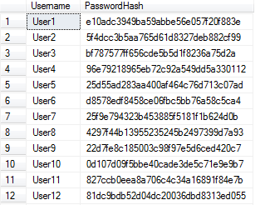
Practical hashing
Storing Passwords
Hash is stored instead of actual password
Hashes will be compared instead of password
Original password can’t be retrieved
Verifying a downloadable file
Website provides the hash
If hash is the same, the document hasn’t been altered
Digital Signatures
Provides proof that a message was not changed
Also makes sure that a fake signature was not used
Contains both a private and public key
Stored Hashed passwords
Signer signs document
Signature hashed (private key)
Document sent
(Data and signature)
Data hashed
(public key)
Signature hash and data hash are compared to verify

